Slide 1
EGG-sploring the search space.
John Taggart

Slide 2
Terminology
Equality saturation
Determines optimal compiled output.
Iteratively explores possible rewrites.
Widely applicable.
EGraph
By iteratively merging the contained data using possible rewrites, EGraphs can be used for equality saturation.
EGG
By default, EGG is built using a Breadth-First Search (BFS) design.
EGG’s design makes it easy to swap out different search algorithms.
Notes:
Before we jump in, let me quick go over some concepts my project was about.
Equality saturation is a process used to find an optimal compiled output for a language.
This process can be applied to a variety of contexts, including query optimization.
EGraphs are a data structure that can be used to iteratively achieve equality saturation. They grow based upon the possible rewrites found during the equality saturation process.
EGG (short for “EGraphs Good”) is a program which implements EGraph-based equality saturation.

Slide 3
Project
I adjusted EGG to use different algorithms for exploring the search space during the equality saturation process.
I then benchmarked the performance of these algorithms.

Slide 4
Search Algorithms
Notes:
On to the Search Algorithms I evaluated.
I evaluated four algorithms.

Slide 5
Search Algorithms
BFS.
The EGraph class in EGG is designed around exploring the search space with BFS-based approaches.
BackoffScheduler.
Modified version of BFS.
Uses backoff to reduce excessive EGraph growth in the presence of associativity and commutativity.
This is EGG’s default search algorithm.

Slide 6
Search Algorithms
Beam search.
BFS-based.
Only works with a subset “beam” of elements in each level.
Each beam’s size is called the “beam width”.
Beam search can be optimized by choosing elements based upon a certain criteria.
I arbitrarily chose the matches obtained by the beam. My implementation chose whatever the first beam_width items were in the beam.
Incomplete, so it is not guaranteed to return the optimal output.
Implemented with beam widths of 100, 40, and 20.
Depth-First Search (DFS).
Significantly harder to implement since EGG is built around BFS.

Slide 7
Recording performance.
Ran 6 different EGG test suites for each algorithm.
Recorded the following data for each test suite run:
Runtime.
Peak memory usage.
Number of iterations to achieve equality saturation.
Best EGraph variant computed.
Notes:
EGG test suites:
transitive – tests based around evaluating transitive boolean operations. [5]
lambda – tests based around lambda calculus. [5]
math – tests using a language of various mathematical operations. [5]
prop – tests using some propositional language. [5]
simple – tests using a language with commutative addition and multiplication. [5]
udp – tests which evaluate UDP query equivalence using EGG. [3]
Runtime recorded using Unix’s “time” command to output the runtime of each test suite in milliseconds.
Peak memory usage recorded using a script I found on GitHub that records the highest memory usage output of a process.
Number of iterations was recorded by adding a simple print statements to EGG.
Each test evaluates that the best possible EGraph variant is computed, so I measured the quality of the computed EGraphs by evaluating whether the tests passed/failed.

Slide 8
Recording performance.
Each metric recorded was individually.
Each test run five times and the lowest value was recorded.
Data was adjusted to be the percent-difference from the data recorded for basic BFS.
Excluded data from test suite failures.
Machine specs: ARM-based 2021 10-core M1 Pro Mac with 16GB RAM.
Notes:
Each metric recorded was individually to avoid having them influence each other.
To ensure that my benchmark measurements accurately represented the algorithms they were evaluating, I ran them five times each and then recorded the lowest value. If there were any outlier results, I reran the tests until I had five consistent values in-a-row.
Adjusting data to be %difference allows it to be more readable and understandable.
Since “beam search” does not search the whole search space, it failed certain test suites. Test suite failures indicate poor behavior and broke the metrics I used, so I excluded data from test suite failures. Failures are marked with “X” on the result tables.

Slide 9
Results
Notes:
As stated earlier, these results are percentage differences from BFS executions.

Slide 10
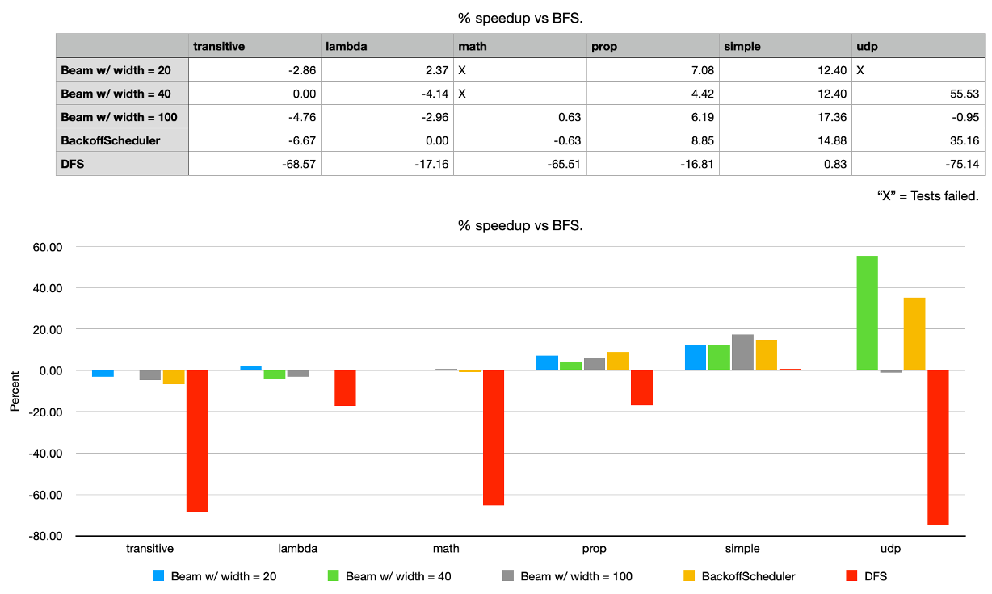
Higher = % faster, lower = % slower.
Notes:
Runtimes were the worst for DFS across all suites.
For the cases where they succeeded, the Beam Search algorithms with beam widths of 20 and 40 outperformed the rest of the algorithms. This is because they had to explore a smaller search space.
Overall, the BFS algorithms performed similarly across all test cases.

Slide 11
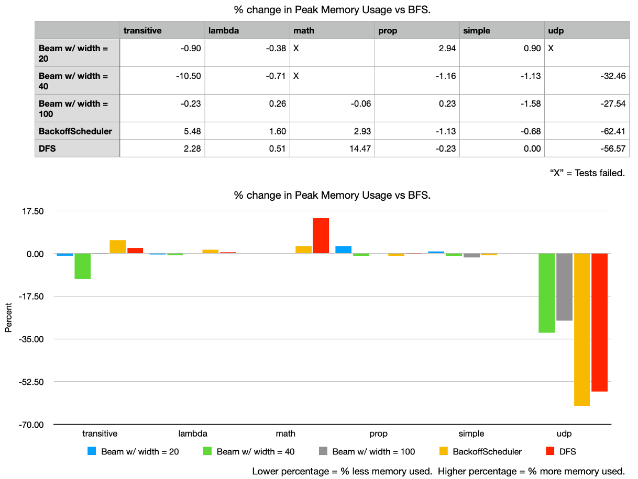
Notes:
The results of my peak memory usage tests show no clear “best” or “worst” algorithm across all test suites.
In the udp suite, all the algorithms tested performed significantly better than default BFS, with BackoffScheduler consuming the least memory.
In the transitive suite, my beam search with a beam width of 40 used the least memory of all algorithms. This is not surprising: beam search operates via reducing the search space, which would lead to less resource usage.

Slide 12
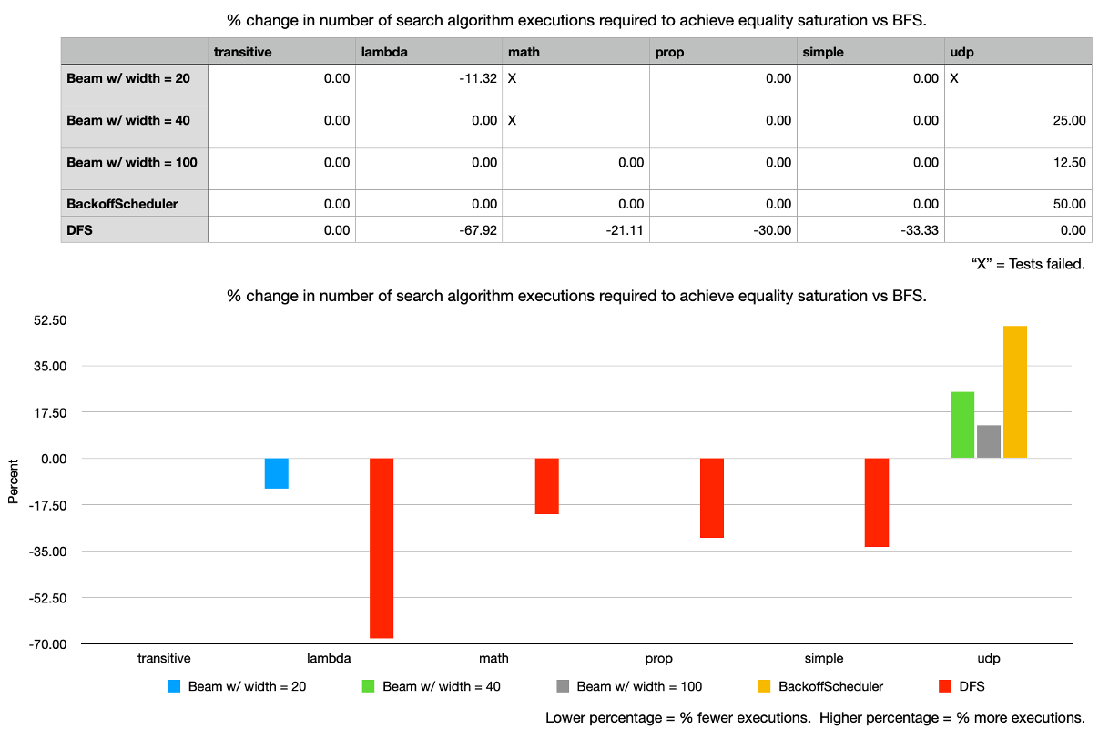
Notes:
Across all test cases, DFS achieved equality saturation with the fewest number of search algorithm executions. By going depth-first, DFS has more thorough computations with each execution of its search algorithm than the other breadth-first-based algorithms. As seen earlier though, this comes at a significant runtime cost.
All other algorithms performed roughly the same across all test suites. This is likely because they’re all derivatives of BFS.

Slide 13
Best EGraph “variant” computed.
Computed the best possible EGraph:
BFS
BackoffScheduler
Beam Search w/ beam width of 100.
DFS.
Failed to compute the best possible EGraph:
Beam Search with beam width of 40.
Failed the “math” test suite.
Beam Search with beam width of 20.
Failed the “math” test suite.
Failed the “udp” test suite.
Notes:
Failures are because the algorithm was incomplete + the beam was not wide enough for the optimal variant to be computed.
The Beam Search case with a beam width of 100 only succeeded because a beam width of 100 was sufficient for searching these test cases for the optimal variant.
There certainly exists use-cases for EGG where a beam width of 100 would not be sufficient for find the optimal variant.
In those cases the beam search algorithm will fail to find the optimal result.

Slide 14
Conclusions
Beam search is great for certain scenarios.
Tradeoff accuracy for runtime memory usage.
Safe to use if search space will never become too big for beam width.
Safe to use if subpar results are sufficient.
BFS-based approaches are the best for equality saturation.
Of the BFS-based approaches, EGG’s default BackoffScheduler is the best.
Slight optimizations do not impact output quality.
Allows for reasonable performance improvements in most situations.

